Slide 1
Algebra
Topic: Number Sentences
EQ: How do we write number sentences?
Mrs Stretch
Year

Slide 2

Memory Madness
Without looking back in your book, how many words can you remember that means the same as the following 4 words:
Addition
Subtraction
Multiplication
Division

Slide 3
Addition +
Add
Sum
Plus
Both
Combined
Increase
Total
Join
Subtraction -
Decrease
Difference
Left over
Minus
Reduce
Remains
Remove
Take Away
Multiplication x
By
As much
Equal Groups
Multiply
Lots of
Product of
Times
Division ÷
Average
Divide
Each
Equal Parts
Evenly
Out of
Quotient

Slide 4
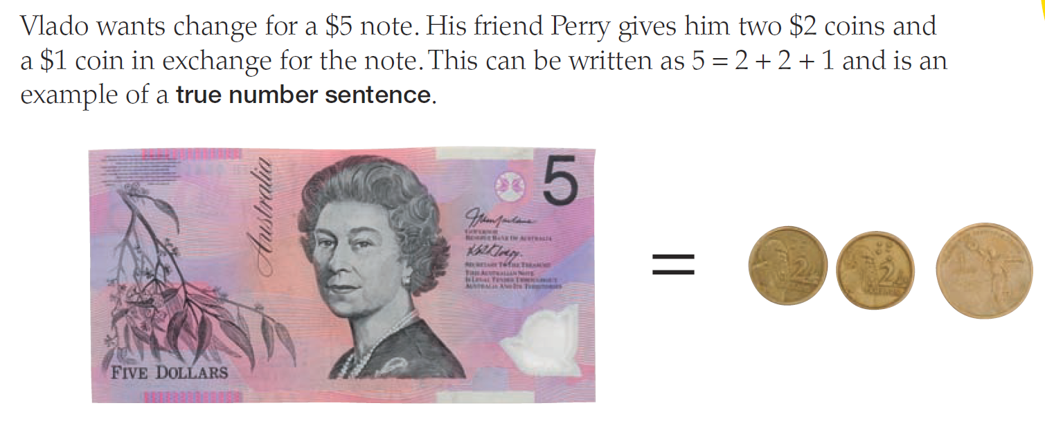
24
7
30
Number Sentences
Date
EQ – How do we write number sentences?

Slide 5
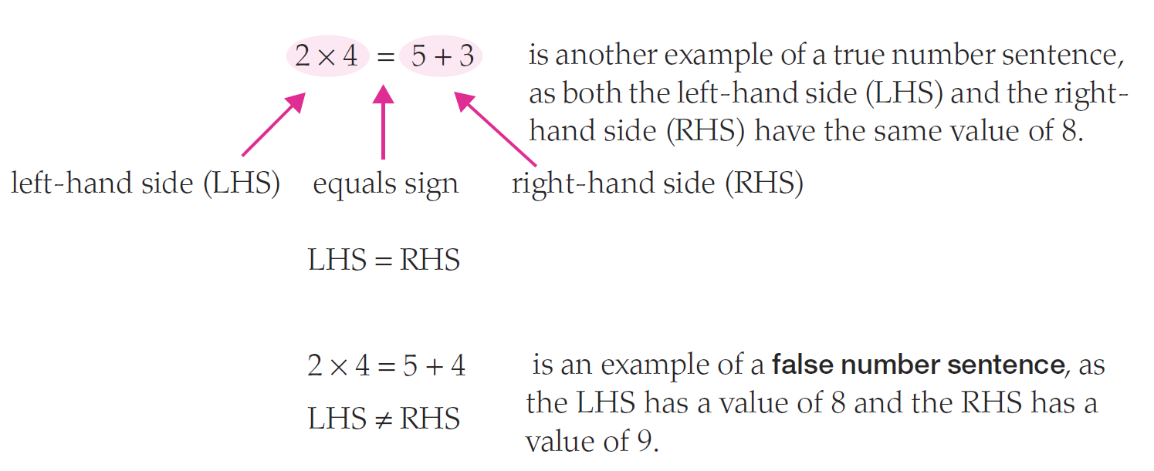
24
7
30
Number Sentences
Date
EQ – How do we write number sentences?
What is a number sentence?
When the left hand side of the equation is EQUAL to the right hand side of the equation.

Slide 6
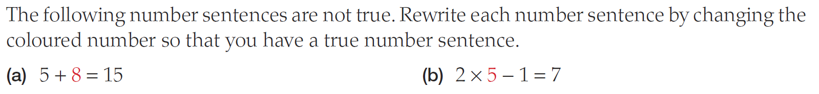
24
7
30
Number Sentences
Date
EQ – How do we write number sentences?

Slide 7
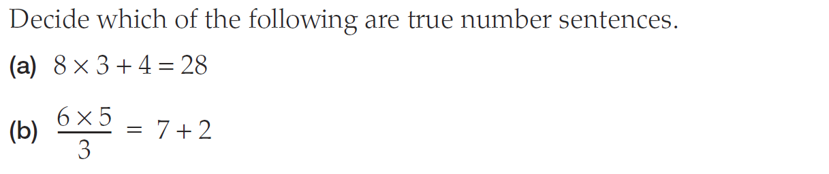
24
7
30
Number Sentences
Date
EQ – How do we write number sentences?

Slide 8


Slide 9
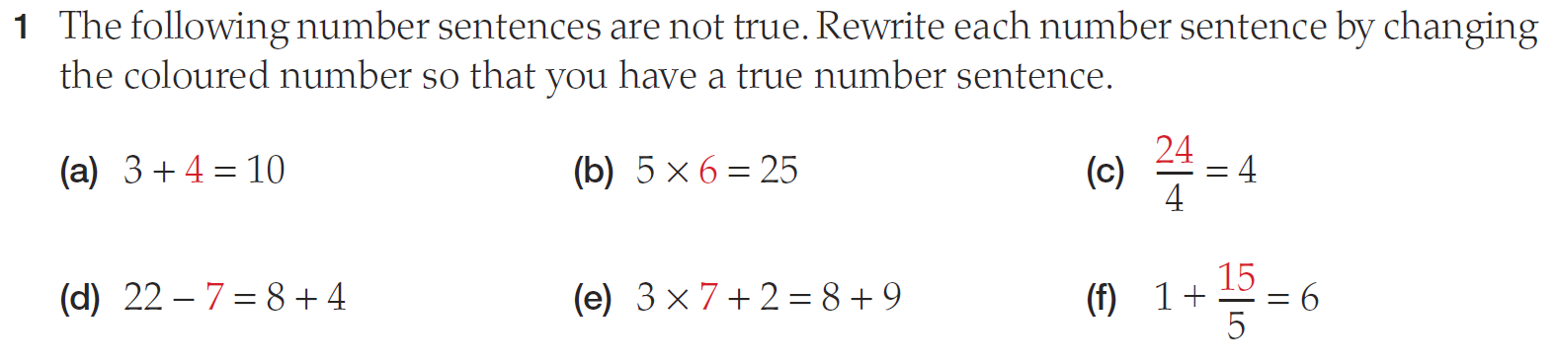
Practice

Slide 10
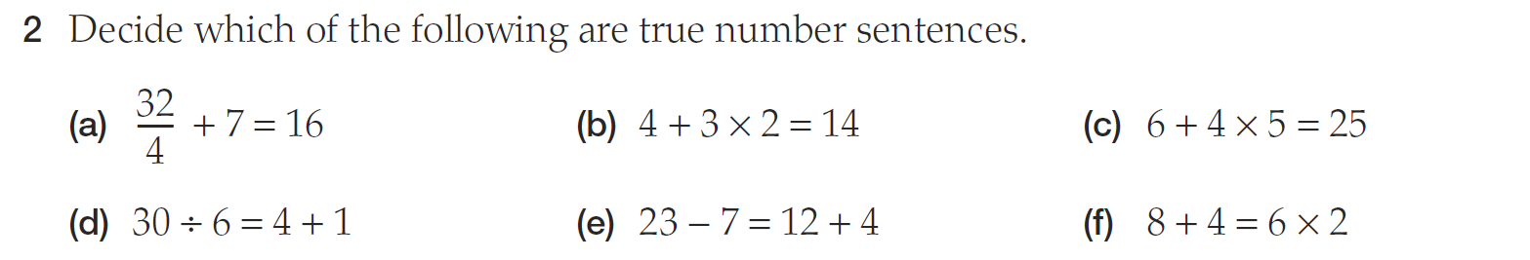
Practice

Slide 11
24
7
30
Number Sentences
Date
EQ – How do we write number sentences?

Slide 12
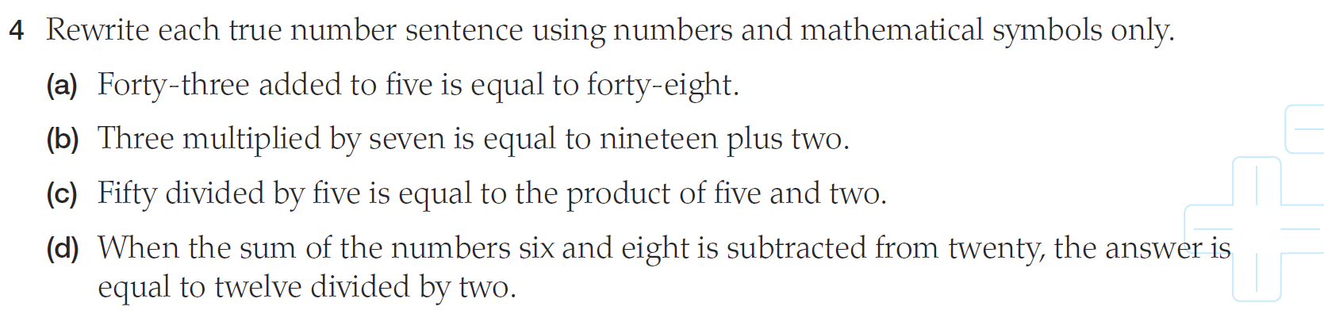
Practice

Slide 13
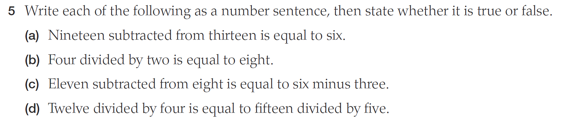
Practice

Slide 14
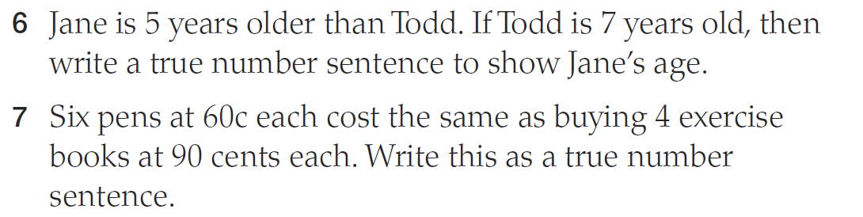
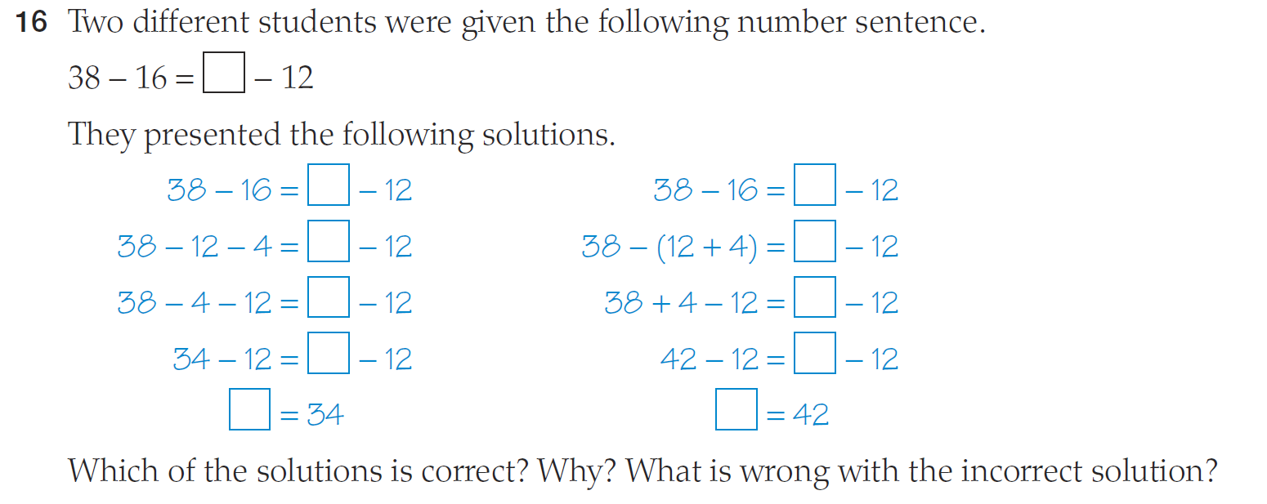
Extension

Slide 15
